Slide 1
AutoDrive
"Your car, our care."

Slide 2
Research Process
Stakeholder Interview
Competitor Analysis
Survay
User Interview
Persona

Slide 3
Stakeholder Interview

Slide 4
Questions
Is accessible everywhere in Egypt, including rural and hard-to-reach areas
Who
Customers (from 15 years ) & Drivers
What
A Transportation Application for everywhere
Why
Enable the application to access inaccessible locations.
Facilitate swift and cost-effective delivery of goods.
Available 24/7
Where
When

Slide 5
Competitor Analysis

Slide 6
Competitor Analysis Comparison Chart
Best Features | Best For | Pricing | Support | Inaccessible Areas | Delivery
Safety | Safe for teens and women | 2.75E for Km | Customer service number and contact driver | ❌ | ❌
Safty | Safe for teens and women | 3.75E for Km + waiting time | Customer service number and contact driver | ❌ | ❌
Customers determine price | Individuals who prefer "pre-priced services" | Negotiate the price | Customer service number and contact driver | ❌ | ❌
Uber Careem inDrive Didi
Cheapers offers | All people | 2.45E for Km | Customer service number and contact driver | ❌ | ❌

Slide 7
Features list

Slide 8
Features list
Goods and Package Delivery:
Enable users to request the delivery of
goods or packages to specified locations.
Implement a secure and reliable delivery
system.
Ride-Sharing Services:
Facilitate transportation for individuals by connecting them
with nearby drivers.
Offer various vehicle options based on user preferences
and needs.
Access to Inaccessible Areas:
Provide services to reach areas that may be challenging to access through traditional transportation means.
Negotiation Feature:
Allow users to negotiate prices
with drivers or delivery providers.
Payment System:
Integrate a secure and convenient payment gateways for users to pay for services within the app.
Include options for cashless transactions.

Slide 9
Survay

Slide 10
Survey Link
https://docs.google.com/forms/d/e/1FAIpQLSeqQJBPW_1FKyPDRWlaH3A2BXU3pNPKGKg1L89E7q-2FovfKQ/viewform?usp=pp_url

Slide 11
User Interview

Slide 12
User interview who deals with Uber :
What problems do you face with Uber?
How many times have you felt unsafe with Uber?
Have you face any objection from driver of reaching to a specific location ?
Did the driver not arrive on his time before?

Slide 13
Persona

Slide 14
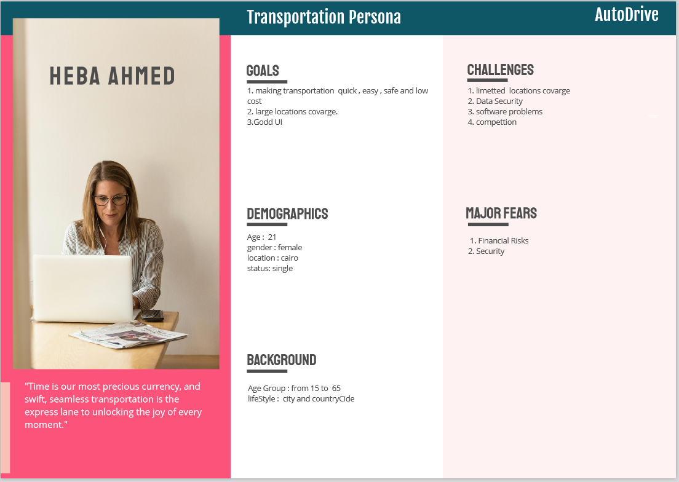

Slide 15
thank you
Fatma Metwally Taha
Eman Ahmed Arafa
Alaa Abdelraheem Senussi
Asmaa Mohammed Wasel

